Slide 1

ICT504 IT Strategy & Leadership Week 4 Strategic Business and Technology Analysis

Slide 2
Lecture Outline
Business & ICT Alignment
Business Vision
Business Operating Model (Part 1)
Business Operating Model (Cont.)
Quick Comparison Table
Business Cultural Model (Denison’s Model)
Managing Information in Business (Socio-Technical Model)
Technology Strategic Radar
DIKAR Model – Technology to Business Objectives
Technology & Business Objectives – Perspectives
Discussion Questions/Hands-On Activities/Problem-Solving
Redesign/Design Process
Process Engineering / Reengineering

Slide 3
Business & ICT Alignment
Business and ICT strategies must go hand-in-hand.
ICT supports business growth and also inspires new business ideas.
When business leaders understand technology, better strategic decisions follow

Slide 4
Business & ICT Alignment
Australian Example: Woolworths uses ICT (like AI-driven inventory systems) to align with its strategy of minimizing waste and ensuring product availability.

Slide 5
Business & ICT Alignment
Discussion Question: Why is it risky if ICT is developed without consulting the business side?
Suggested Answer: Because it may lead to systems that don’t meet business goals or user needs.

Slide 6
Business & ICT Alignment
Hands-On Activity: Match business goals (like “expand to new markets”) to ICT strategies (e.g., “cloud deployment” or “e-commerce”).
Problem-Solving Example: Your business wants to reduce customer wait time. What ICT strategy would you suggest?
Answer: Implementing a mobile queue management or chatbot support system.

Slide 7
Business & ICT Alignment
Debate Prompt: "Should ICT lead business strategy in modern companies?" (Split the class to argue each side.)

Slide 8
Business Vision
A business's mission, vision, and KPIs guide ICT needs.
Business plans define short-term and long-term tech requirements.
ICT is needed to achieve results and to track performance.

Slide 9
Business Vision
Australian Example: Qantas' digital transformation aligns with its vision to be the safest and most customer-focused airline through its mobile app, loyalty program, and AI-based route optimization.

Slide 10
Business Vision
Discussion Question: How can a KPI like “reduce carbon footprint” shape ICT strategy?
Answer: It may lead to investing in green data centers or paperless operations.

Slide 11
Business Vision
Hands-On Activity: Students list three KPIs from a real business (e.g., Telstra) and suggest ICT tools that support them.
Problem-Solving Example: If a company wants to increase customer satisfaction, what ICT solution should be implemented?
Answer: CRM systems and data analytics dashboards for real-time feedback.

Slide 12
Business Vision
Role-Play: One student plays a CEO, another the CIO. Discuss if the IT budget should go toward mobile-first or ERP integration.

Slide 13
Business Operating Model (Part 1)
Shows how business activities and tech processes work together.
Helps explain the system clearly to both tech and business staff.
Highlights messy workflows or disconnected departments.

Slide 14
Business Operating Model (Part 1)
Australian Example: Centrelink integrates citizen data across departments to streamline welfare delivery—this reflects an optimized business operating model.

Slide 15
Business Operating Model (Part 1)
Discussion Question: Why is it important for IT teams to understand business processes?
Answer: To create systems that actually solve real problems and fit how work happens.

Slide 16
Business Operating Model (Part 1)
Hands-On Activity: Draw a simple business process (like online book orders) and identify ICT touchpoints.
Problem-Solving Example: A company has two systems that don’t “talk” to each other. What problem does this cause?
Answer: Data duplication, slow decisions, and inefficiencies.

Slide 17
Business Operating Model (Part 1)
Debate Prompt: “Which should come first: fixing business processes or implementing new ICT systems?”

Slide 18
Business Operating Model (Cont.)
Map apps to the processes they support.
Helps spot what’s outdated or what needs replacing.
Encourages standard processes across global offices.
Combines and streamlines data use.

Slide 19
Business Operating Model (Cont.)
Australian Example: Australian Taxation Office (ATO) integrates MyGov systems and tax software for seamless national tax processing.
Discussion Question: How does mapping apps to processes help a company?
Answer: Reveals where systems are redundant or underused and guides future upgrades.

Slide 20
Business Operating Model (Cont.)
Hands-On Activity: Students map software used by a university (like Canvas, Zoom, Student Portal) to academic processes.
Problem-Solving Example: A company uses 5 different tools for customer support. What ICT recommendation would you make?
Answer: Consolidate into one CRM like Salesforce for consistency and better reporting.

Slide 21
Business Operating Model (Cont.)
Role-Play Prompt: IT Manager vs. CFO – Should we standardize all business processes globally or allow local freedom?

Slide 22
Quick Comparison Table
Concept | Purpose | Example (Australia)
Business & ICT Alignment | Align ICT tools with business goals | Woolworths AI for inventory
Business Vision | Guides ICT needs using KPIs and goals | Qantas loyalty & mobile strategy
Operating Model | Shows how biz processes & tech interact | Centrelink integrated services
Process Mapping | Match systems with processes to reduce gaps | ATO & MyGov integration

Slide 23
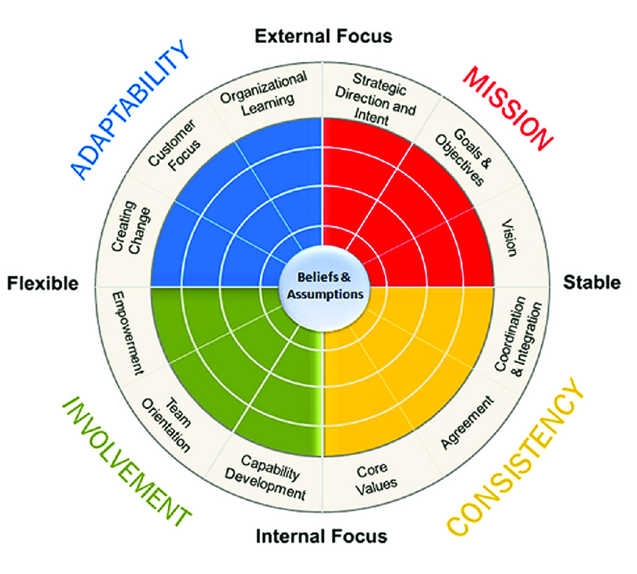
Business Cultural Model (Denison’s Model)
https://www.researchgate.net/figure/Denisons-model-of-organizational-culture_fig2_331461953

Slide 24
Business Cultural Model (Denison’s Model)
Main Idea: Business culture shapes how people behave and perform. Denison’s model includes four key areas:
Trait | Focus | Example (AU)
Adaptability | External + Flexible | A café changing its menu after customer feedback
Involvement | Internal + Flexible | Telstra giving employees more decision-making power

Slide 25
Business Cultural Model (Denison’s Model)
Trait | Focus | Example (AU)
Consistency | Internal + Stable | Qantas aligning staff through strong values
Mission | External + Stable | CSIRO working toward clear scientific goals
Core: Beliefs and assumptions drive these traits.

Slide 26
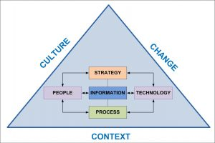
Managing Information in Business (Socio-Technical Model)
http://www.managinginformation.org/socio-technical-systems-model/

Slide 27
Managing Information in Business (Socio-Technical Model)
Main Idea: Managing information well needs balance between people, process, and tech — all within culture and change.
Triangle Elements:
Culture & Change: Influence success of systems
People: Roles, training, attitudes
Technology: Tools/software (e.g., MYOB, Xero)
Process: Workflows that ensure data flows correctly
Strategy: Guides how info is used to meet goals

Slide 28
Technology Strategic Radar
Main Idea: Before using or upgrading tech, we must assess our current vs. future state.
Checklist Before Tech Adoption:
Where are we now vs. future?
What operational issues exist?
Are our processes aligned?
How well do systems connect?
What are the Critical Success Factors (CSFs)?

Slide 29
Technology Strategic Radar
Example (AU): A small logistics firm in Sydney reviewing how well their tracking system integrates with customer delivery apps.

Slide 30
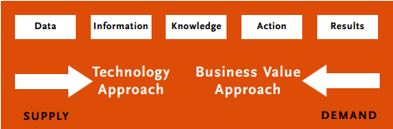
DIKAR Model – Technology to Business Objectives

Slide 31
DIKAR Model – Technology to Business Objectives
Main Idea: To create value, businesses turn data into results.
Step | Description | Example (AU)
Data | Raw facts | Customer purchases at Woolworths
Info | Organised data | Average spend per customer
Knowledge | Insights from info | Popular shopping times
Action | Decisions based on knowledge | Increase staff during peak times
Results | Measurable outcomes | Increased sales, better service

Slide 32
Technology & Business Objectives – Perspectives
Main Idea: Technology must support different business perspectives:
Financial: Cost-saving (e.g., accounting software)
Customer: Better experience (e.g., online booking)
Operations: Streamlining tasks (e.g., automation)
Learning: Upskilling staff (e.g., digital training)
Process: Improving workflows (e.g., CRM systems)

Slide 33
Discussion Questions
Which part of the Denison model do you think is most important for a startup? Why?
→ Adaptability, because startups need to respond quickly to change.
2. Why is culture important in managing information systems?
→ Because even the best tech fails without supportive people and processes.

Slide 34
Discussion Questions
How would you assess tech readiness in a small business?
→ Check current tools, gaps in workflows, and staff skill levels.
Give an example of DIKAR in real life (Australian business context).
→ Woolworths uses customer data (loyalty cards) to give targeted offers.

Slide 35
Discussion Questions
Which perspective (financial, customer, etc.) do you think tech supports the most in your experience?
→ Customer, because apps and websites make service easier and faster.

Slide 36
Hands-On Activities
Business Culture Audit: Interview a local business (or simulate) and map their culture using the Denison model.
Information Mapping Exercise: Draw a socio-technical diagram for your university’s learning system (e.g., Moodle).
Tech Radar Brainstorm: List 3 tech tools you use. Identify gaps between current use and desired outcomes.

Slide 37
Hands-On Activities
DIKAR Flowchart: Pick a real-world scenario (e.g., Uber Eats). Map its DIKAR journey from data to results.

Slide 38
Problem-Solving Examples
Problem: A business collects lots of customer data but struggles with using it effectively.
Solution: Apply DIKAR to convert data into actionable insights.
2. Problem: A retail company faces delays due to manual order processing.
Solution: Use Tech Radar steps to evaluate integrating inventory management software.

Slide 39
Role-Playing Debate Questions
“Mission is more important than adaptability in business success.”
→ Assign roles: Traditional business (pro-mission) vs. Startup (pro-adaptability)
“Investing in technology always brings business success.”
→ One side supports DIKAR and tech tools, the other highlights human and process factors.

Slide 40
Redesign/Design Process
Concept Summary: This process focuses on improving how work gets done — not just tweaking old systems, but rethinking them from scratch.

Slide 41
Redesign/Design Process
Step | Simple Explanation | Aussie Example
Analyse work | Study current ways work is done | E.g., Australia Post studies parcel sorting
Identify ideal way | Imagine the best way to do it | Use of AI for faster sorting decisions
Develop new method | Create a better system | New software, less manual sorting
Improve linkages | Ensure teams/systems work better together | Integration with e-commerce platforms

Slide 42
Redesign/Design Process
Step | Simple Explanation | Aussie Example
Enable measurement & improvement | Set KPIs to track performance and improve again | Monthly efficiency reports

Slide 43
Process Engineering / Reengineering
Concept Summary: This is about rethinking and rebuilding key processes — often supported by ICT tools — to meet current or future business needs.

Slide 44
Process Engineering / Reengineering
Feature | Explanation in Simple Terms | Example (AU)
Simplification or elimination | Remove unnecessary steps | Streamlining Centrelink service forms
Align with new ICT | Match process with modern systems | NDIS adopting digital portals
Identify information gaps | Check what data is missing or outdated | ATO updating tax data flows from employers
Upgrade capabilities | Add or upgrade tech, staff, suppliers, etc. | MyGov mobile app features rolled out

Slide 45
Research Discussion Questions
What’s the biggest benefit of starting a design process from scratch rather than improving an old one?
→ You avoid carrying over old problems and can fully rethink how things work.
2. Why is ICT so critical in reengineering today’s processes?
→ Because most work now depends on digital tools for speed, accuracy, and integration.

Slide 46
Research Discussion Questions
Can you think of a public service in Australia that was redesigned recently? What changed?
→ Example: MyGov linking Centrelink, Medicare, and ATO services into one portal.

Slide 47
Hands-On Activities
Redesign Workshop: Pick a simple process (e.g., student attendance). Redesign it using tech (QR codes, apps).
Reengineering Audit: Compare two Australian government websites. Which one offers a better user journey? Why?
Gap Analysis Task: Given a list of outdated processes, identify where information or integration is missing.

Slide 48
Problem-Solving Examples
Problem: A university manually enters student grades into spreadsheets.
Solution: Redesign the process using automated LMS (e.g., Canvas + MySQL + script).
Problem: A local council receives paper feedback forms.
Solution: Reengineer using online forms integrated with analytics dashboards (e.g., Power BI).

Slide 49
Role-Playing Debate Questions
“Reengineering is too expensive for small businesses.” → One side supports gradual redesign with open-source tech, other says stick to old methods.
“You must change the tools before changing the process.” → One group argues tech leads, the other says process clarity comes first.

Slide 50
Summary
Discussion about business objectives.
Discussion about technology capabilities and business model impacts on each other.
Evaluating the aspect of process for determining the ICT strategy.

Slide 51

Reading Materials

Slide 52
Articles
J. Ross, P. Weill and D. Robertson, Enterprise Architecture as Strategy: Creating a Foundation for Strategy Execution, Harvard Business School Press, Boston, 2006. 5.J.P. Kotter, Organizational Dynamics: Diagnosis and Intervention, Addison-Wesley, Reading, Massachusetts, 1978. 6.
J.M. Ward and J. Peppard, ‘Reconciling the IT/business relationship: a troubled marriage in need of guidance’, Journal of Strategic Information Systems,
5, 1, 1996, 37–65. 7.
E.M. Daniel and J.M. Ward, ‘Improving the business-IT relationship with IT project portfolio management’, Cutter IT Journal, 28, 1, 2015, 20–24. 8.
J. Peppard and J.M. Ward, ‘Mind the gap: diagnosing the relationship between the IT organization and the rest of the business’, The Journal of Strategic Information Systems, 8, 1, 1999, 29–60.

Slide 53
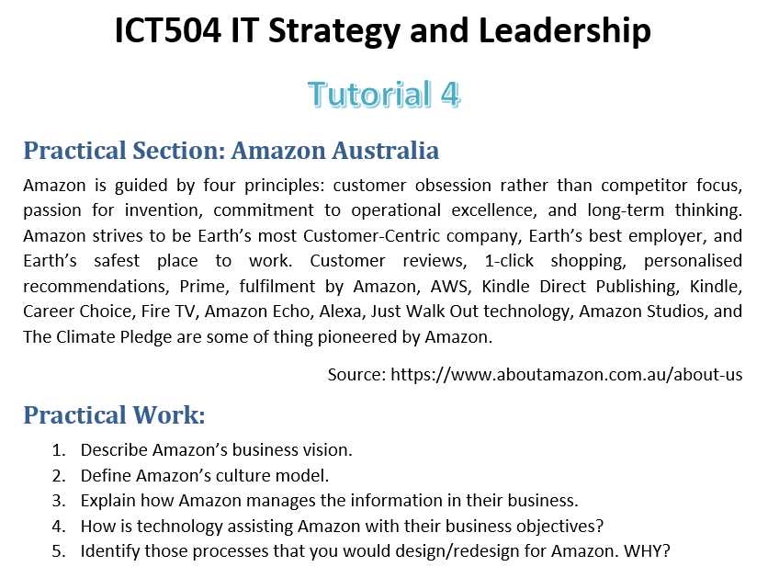
Tutorial Week 4

